Slide 1


Slide 2
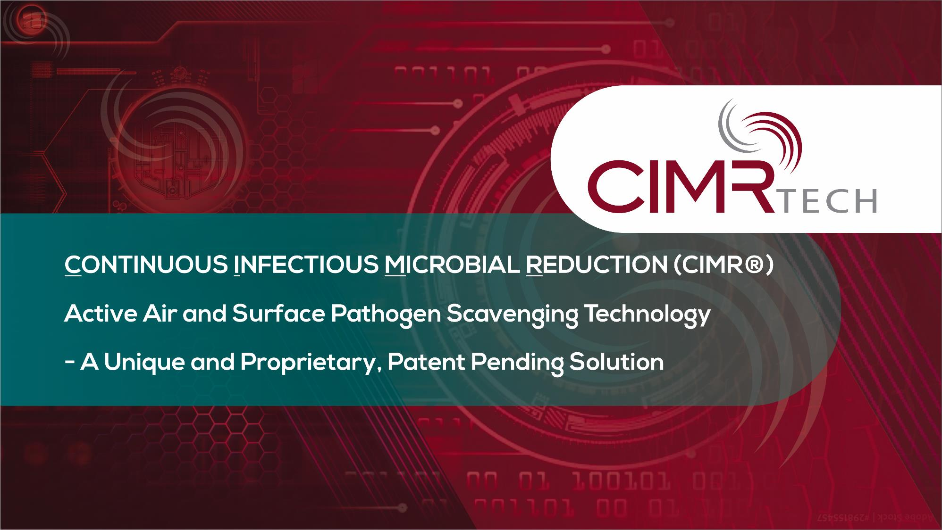

Slide 3

People safely occupy shared indoor air spaces?
Indoor air and surfaces be sanitized effectively to ensure a healthy environment?
We combat and eliminate the transmission and/or spreading of pathogens (viruses, bacteria, fungi, and molds).
We be protected from future variations and mutations 24/7/365.

Slide 4
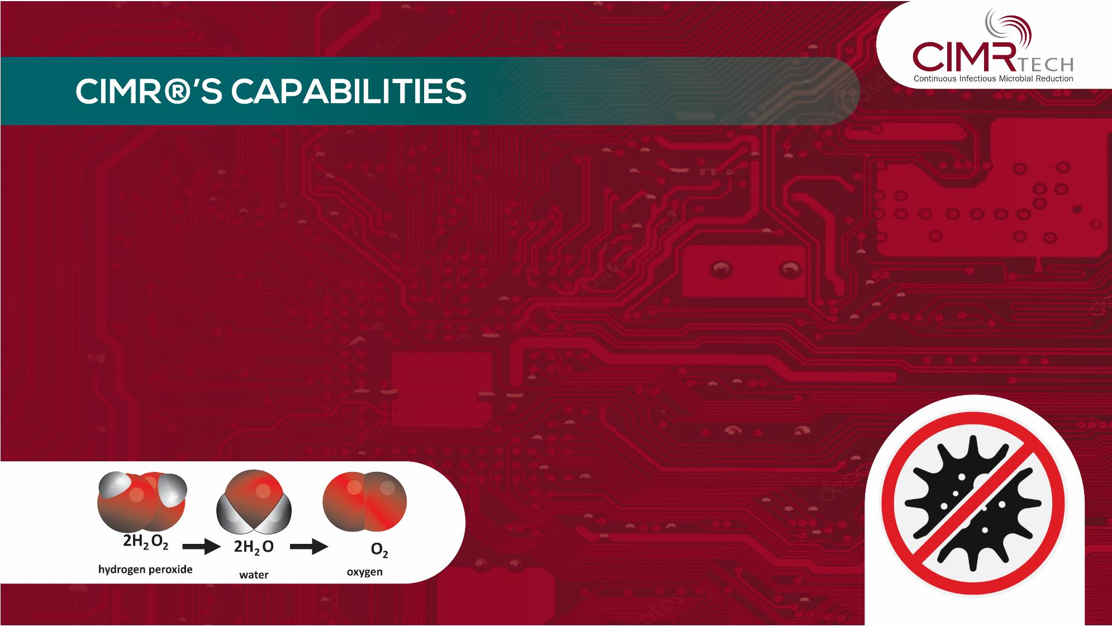
CIMR®'s Air Infusion Technology is designed specifically to kill airborne and surface pathogens.
CIMR® is an ultra-low level, safe and effective Hydrogen Peroxide-based air and surface disinfectant system that produces zero ozone.
Hydrogen Peroxide (water and oxygen) actively targets and deactivates both aerosolized and surface pathogens in enclosed spaces.

Slide 5
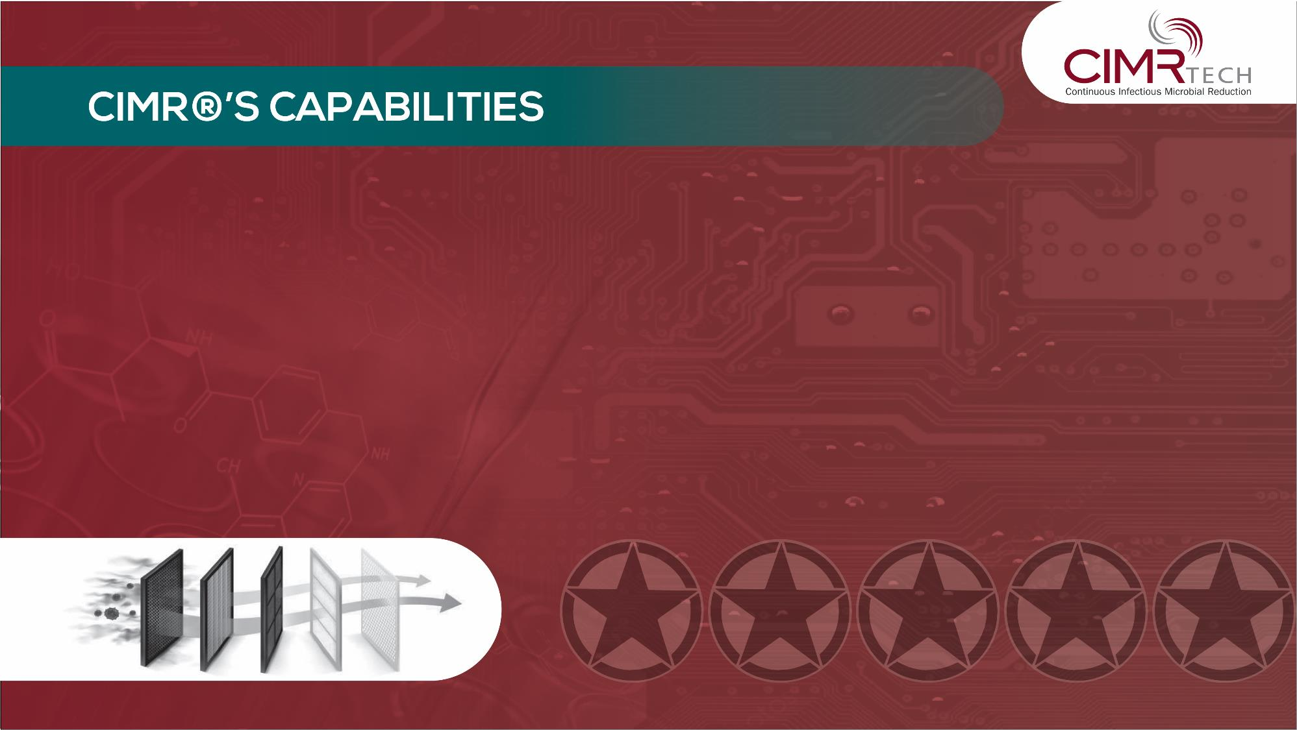
CIMR® produces 0.02 ppm (parts per million) of Hydrogen Peroxide at 1/50th of OSHA (Occupational Safety and Health and Administration) limits.
CIMR® continuously purifies the air much faster than other air filtration
systems and chemicals.
CIMR® is military-grade technology and scientifically proven through numerous independent tests.

Slide 6
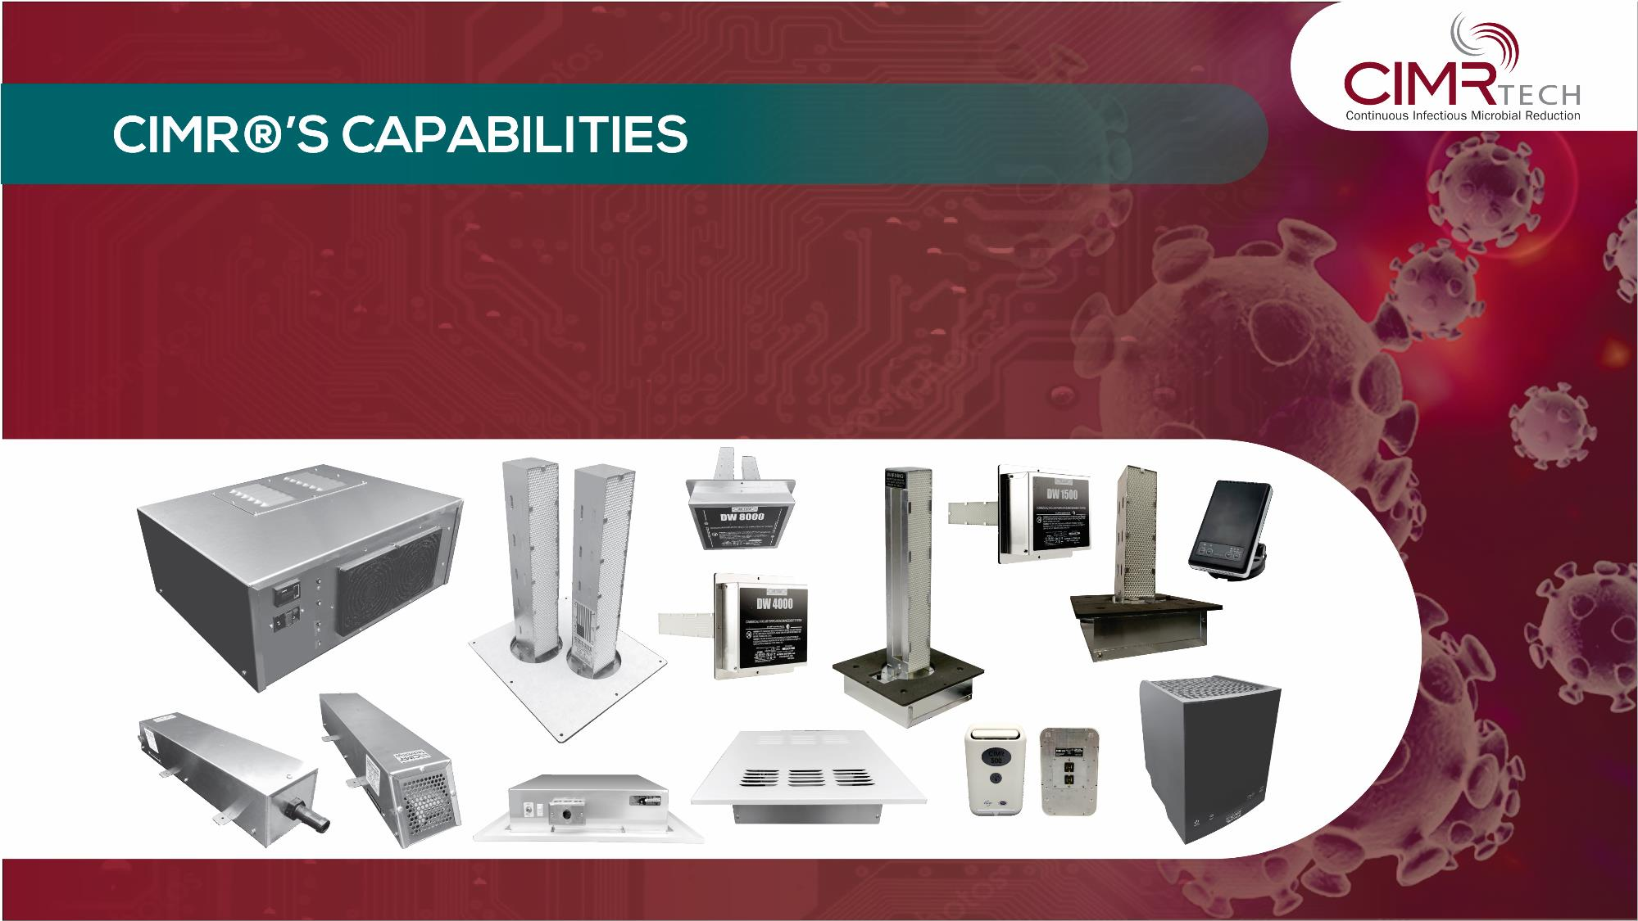
CIMR® eliminates up to 99.999% pathogens.
Similar levels of Hydrogen Peroxide are present in the outside air.

Slide 7
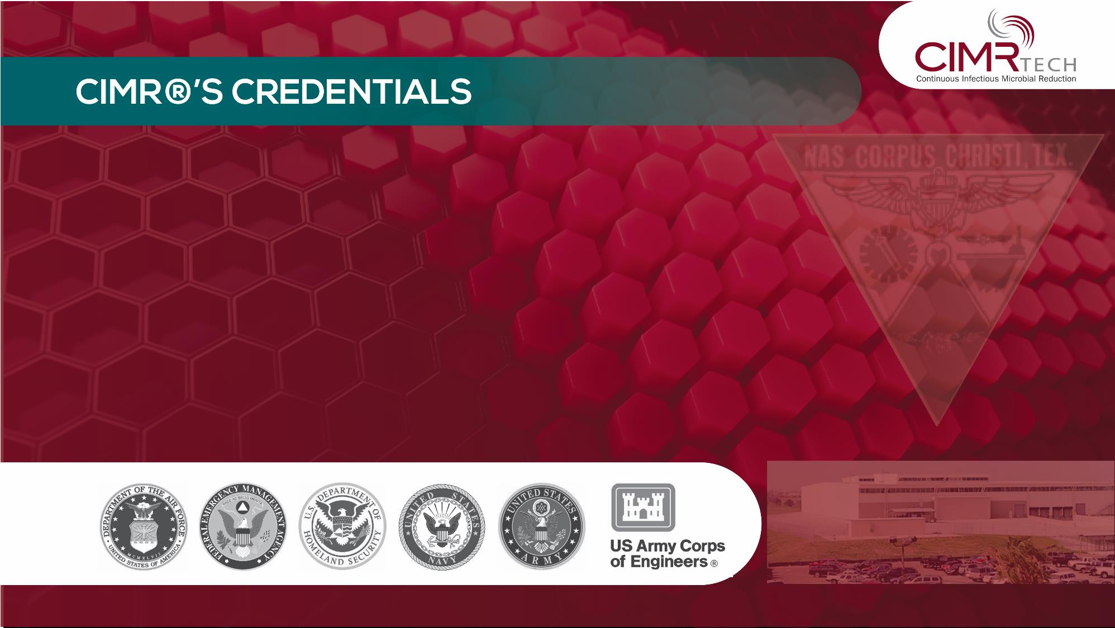
CIMR® was developed in 2004 by Alton Holt while working with the US Army Corps of Engineers, US Army and US Navy.
CIMR®-TECH, a division of HI-TECH, is the only designer, developer,
and supplier of CIMR® Technology, equipment and programs.
HI-TECH provides customized engineering design systems and services based on decades of experience, independent testing and scientific reviews.

Slide 8
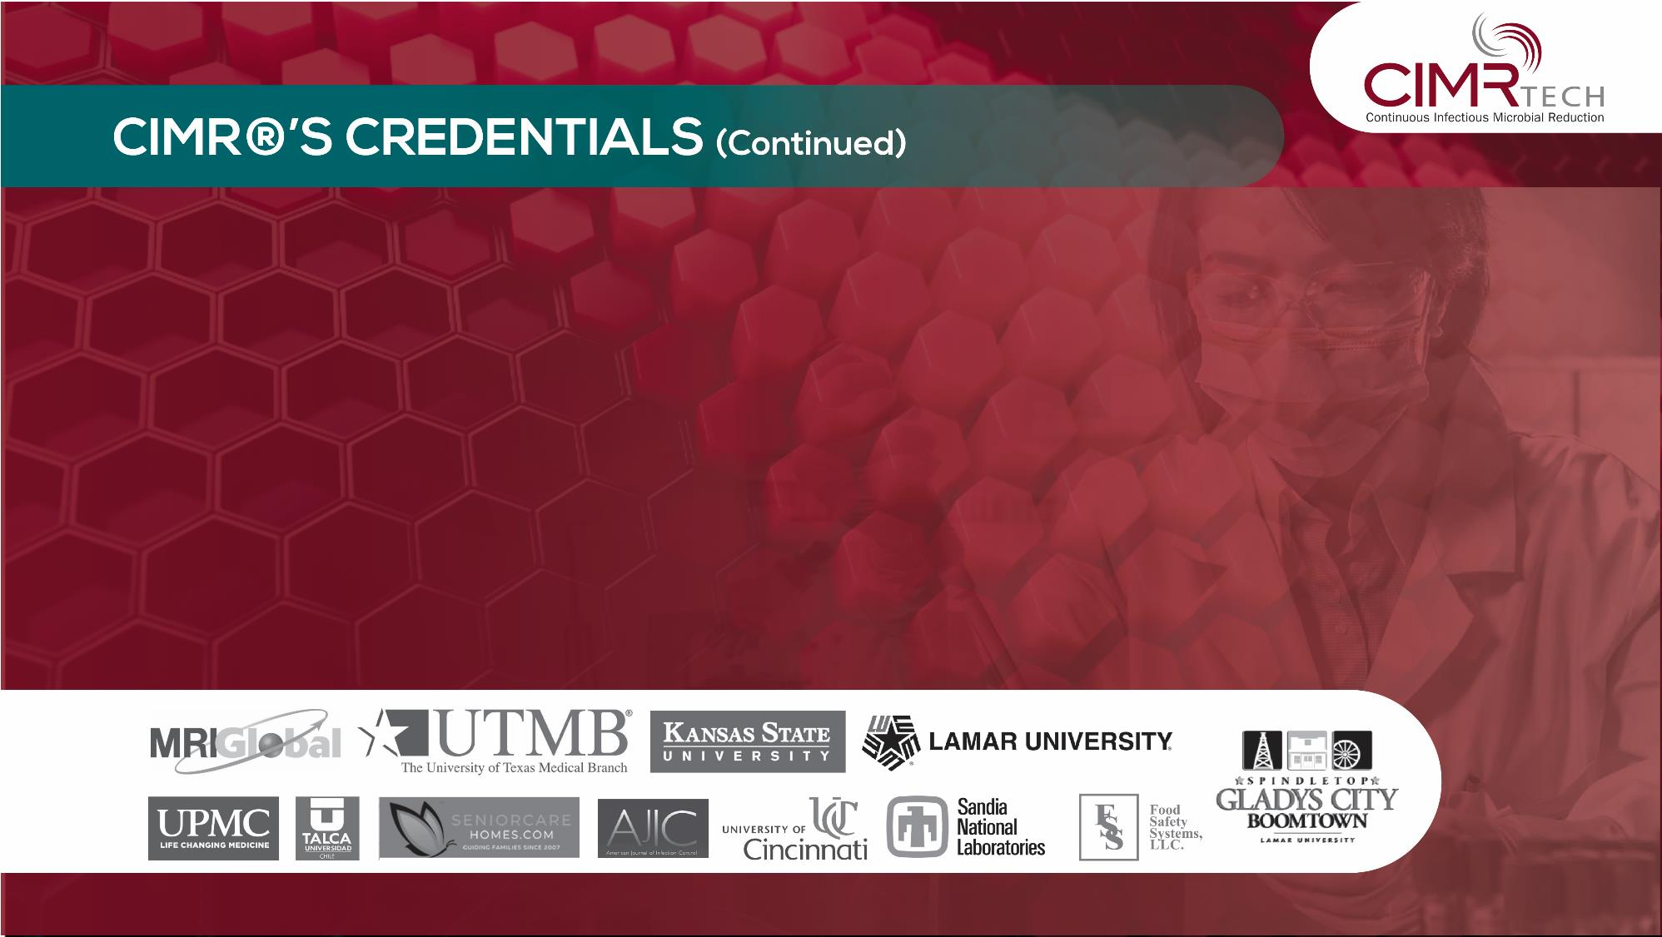
Hundreds of military facilities have been and are using CIMR® with thousands of units installed worldwide.
CIMR® was tested, in accordance with national and international standards as required by regulatory authorities.
CIMR® is registered, and verified by accredited, and independent
authorities, and scientific labs.

Slide 9
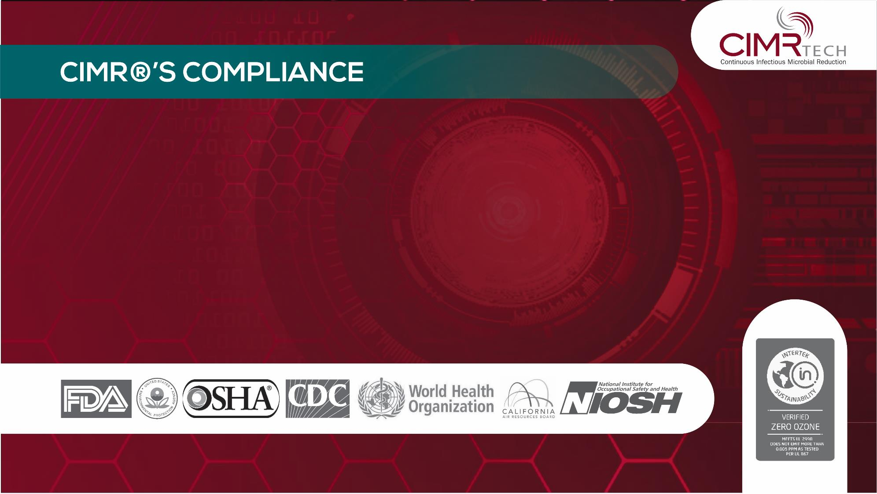
CIMR® is safe and has no adverse effects on humans, animals, metal, wood, fabric, and electronic equipment.
CIMR® is FDA (Food Drug Administration) compliant.
CIMR® carries the CARB (California Air Resources Board) certifying
ZERO ozone emissions.

Slide 10
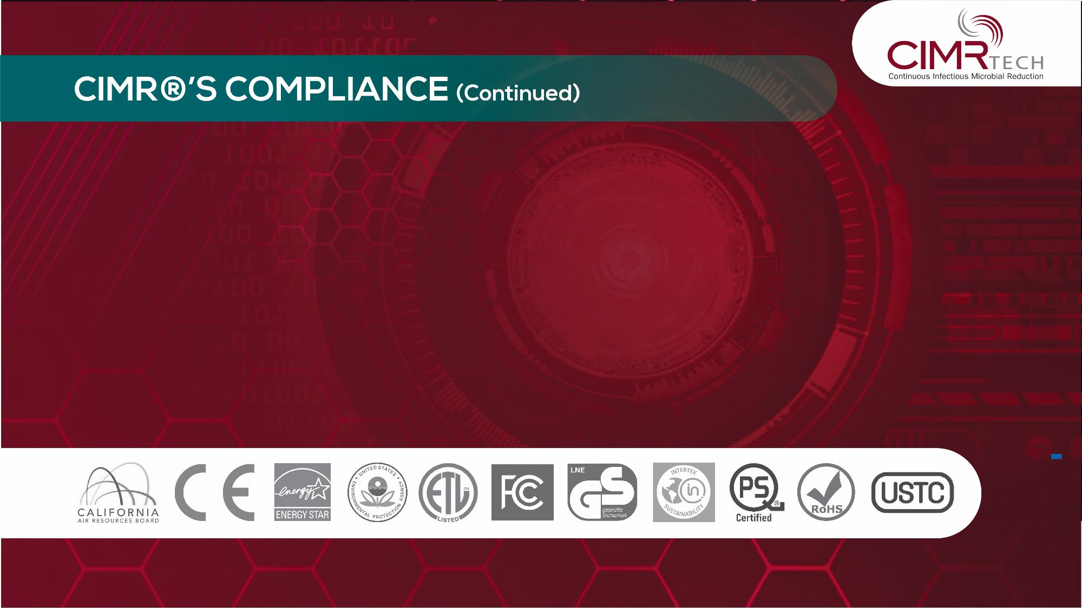
CIMR® meets and exceeds EPA (Environmental Protection Agency), OSHA (Occupational Safety and Health Administration), CDC (Center for Decease Control) and the WHO (World Health Organization) Regulations in Air and Surface Disinfection standards.
CIMR® technology and equipment has achieved various national and international certifications, registrations, compliance seals, and stamps of approval.

Slide 11
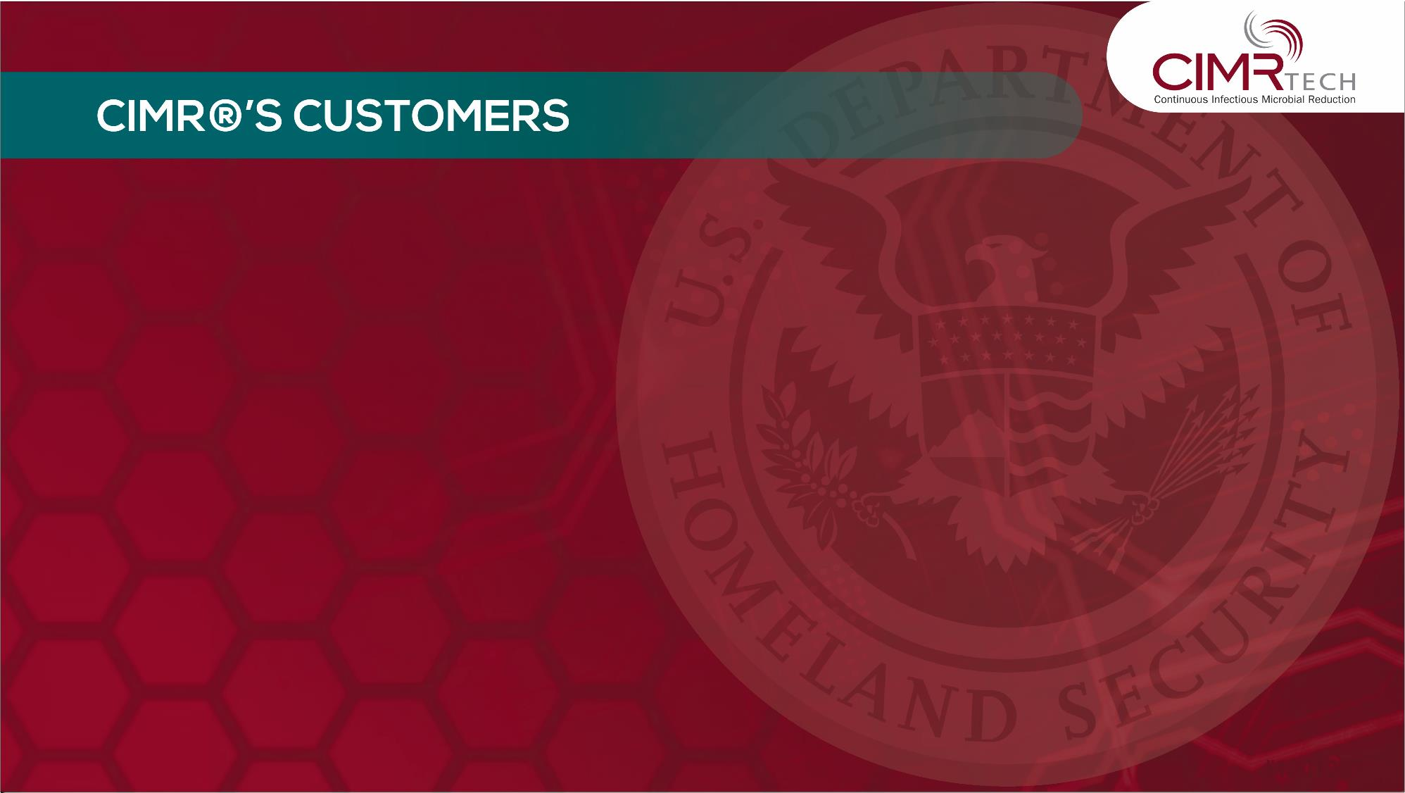
The United States Military, US Army Corps of Engineers, FEMA (Federal Emergency Management Agency),
State and County facilities, United State Department of Homeland Security, and National Historical Society.
Universities, schools and colleges such as Lamar University, Beaumont, Texas, Texas Educational Systems and Houston Baptist University.
Hospitals, clinics, doctor's offices and senior care homes.
Entertainment venues, corporate offices, oil and gas drilling, hotel and leisure facilities.
Shelters, food production and processing facilities, places of worship, churches and homes.

Slide 12
